Slide 1
Exploring New Customer Markets
Samuel Yohannes
Paul Strader
Adam Vajdak
Paul Phillips
Notes:
Sam

Slide 2
Overviewverview
An automobile company has plans to enter new markets with their existing products (P1, P2, P3, P4, and P5).
In their existing market, the sales team has classified all customers into 4 segments (A, B, C, D ).
They plan to use the same strategy for the new markets and have identified 2627 new potential customers.
Notes:
Our mandate is to help management of an automobile company, predict the right group of the new customers
After intensive market research, they’ve deduced that the behavior of the new market is similar to their existing market.
Then, they performed segmented outreach and communication for a different segment of customers. This strategy has work e exceptionally well for them. They plan to use the same strategy for the new markets and have identified 2627 new potential customers.

Slide 3
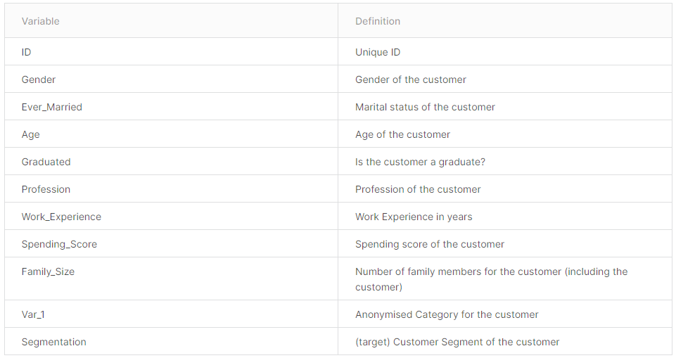
About the Data This dataset contains 10 demographic features and target class, Customer Segmentation: A, B, C, D for over 8,000 observations.
Notes:
Sam

Slide 4
Models and Methods
Arules, Clustering, Classification

Slide 5
Clustering EDA
Training Data Set Segments Existing Clusters into k=4, but is this correct?
If evaluation methods for optimal K suggest should be something else, how to proceed
Re-cluster training data?
Consider business cases for k=4?
Other considerations
Will utilize elbow method for kModes clustering technique
KModes can be applied to categorical data
Notes:
Paul S
Our data set came to us pre-clustered, with the existing customers divided into four segments, with the goal being clustering new customers into one of the four existing customers.
One of our EDA questions was, is k=4 the optimal number of segments for this data.
To answer this we decided to use the elbow method for determining k from kModes due to ease with categorical

Slide 6
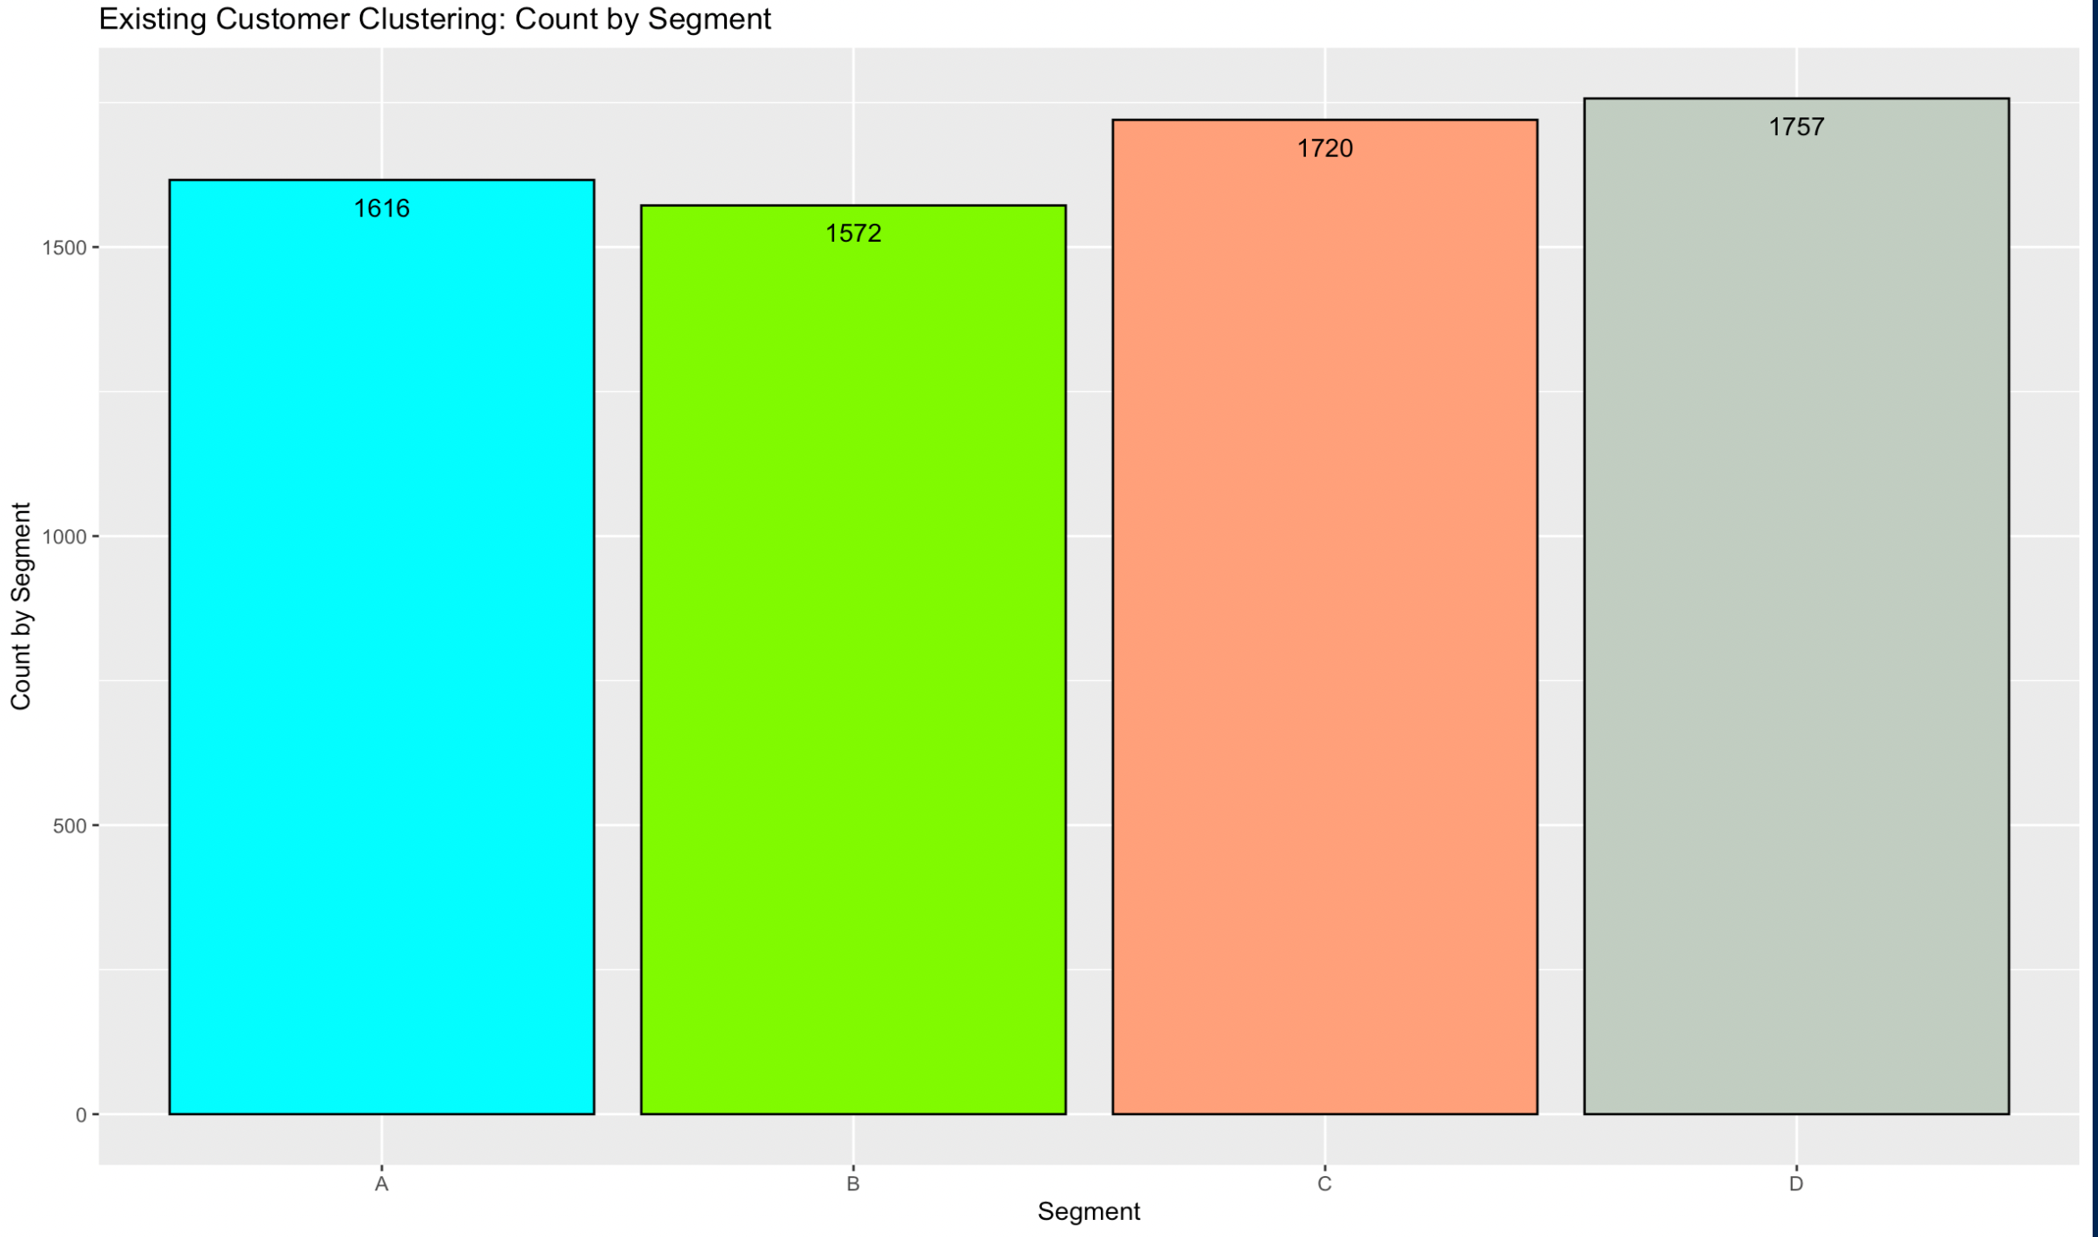
Existing Clusters are Distributed Evenly
.
Notes:
Paul S
This Photo by Unknown author is licensed under CC BY-NC-ND
First step was to evaluate existing clustering, evenly distributed, weighted slightly to segments c and d

Slide 7
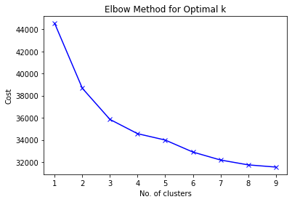
Clustering EDA
kModes Elbow Method Confirms k=4
Notes:
Paul S
Next elbow for kmodes. appears to be an elbow at 3/4 k value...so pre-clustering is reasonable estimate for k

Slide 8
Associate Rule Mining
While it will not be our definitive answer to our question we will use rule mining to understand patterns in our data that can lead us in the right direction for figuring out variables to look for in other methods such as
Rule mining focused on each segment in training data.

Slide 9
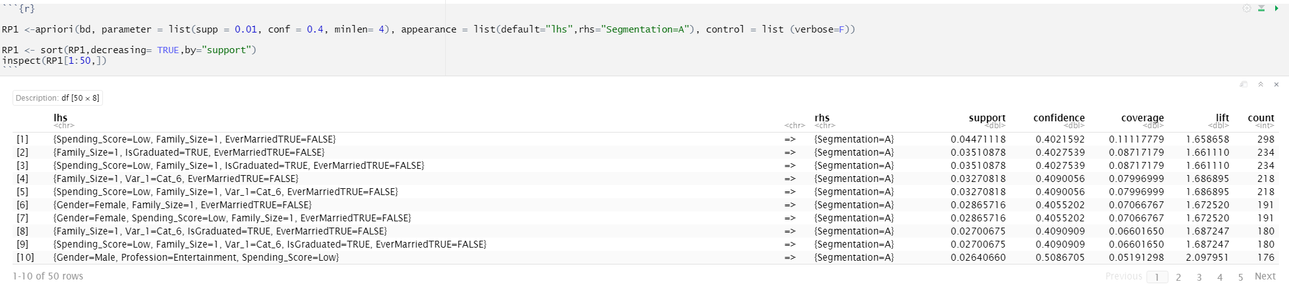
Segment A
Low confidence and support overall.
Spread between rules with high confidence vs high support
High lift
After trying multiple parameters the best was
supp = 0.01, conf = 0.4, minlen= 4

Slide 10
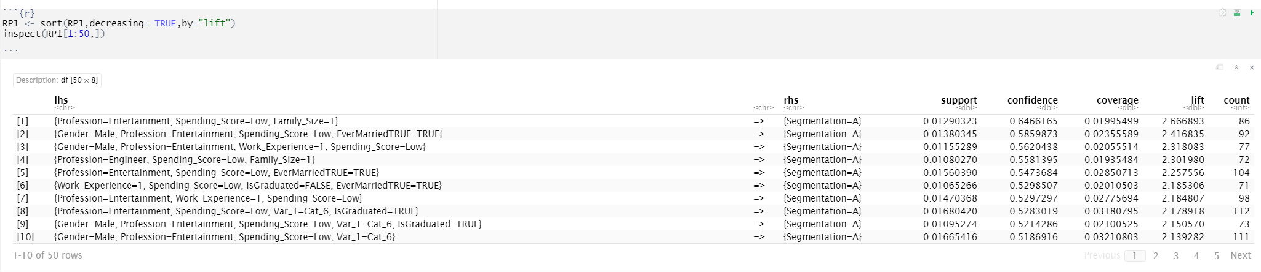
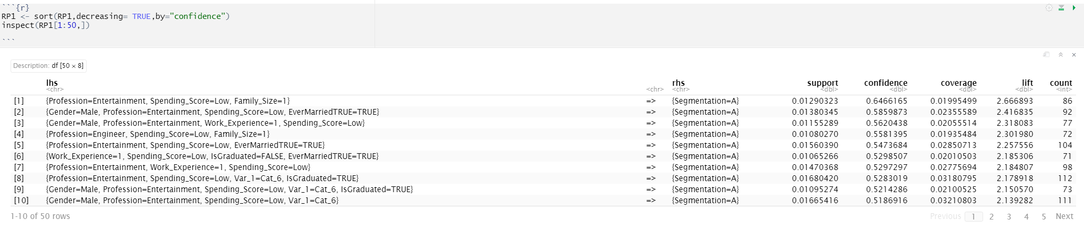
Single people with spending scores at middle age but no definitive answer

Slide 11
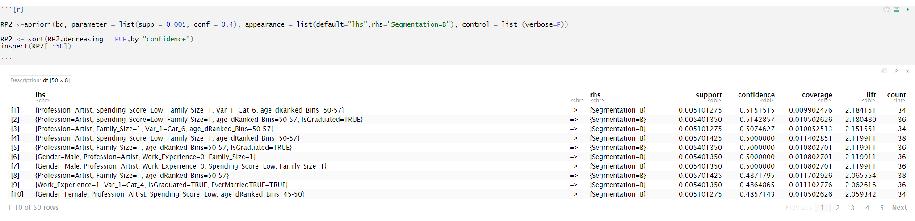
Segment B
Low confidence and support overall. Worse than segment A
Spread between rules with high confidence vs high support
High lift
After trying multiple parameters the best was
supp = 0.005, conf = 0.4

Slide 12
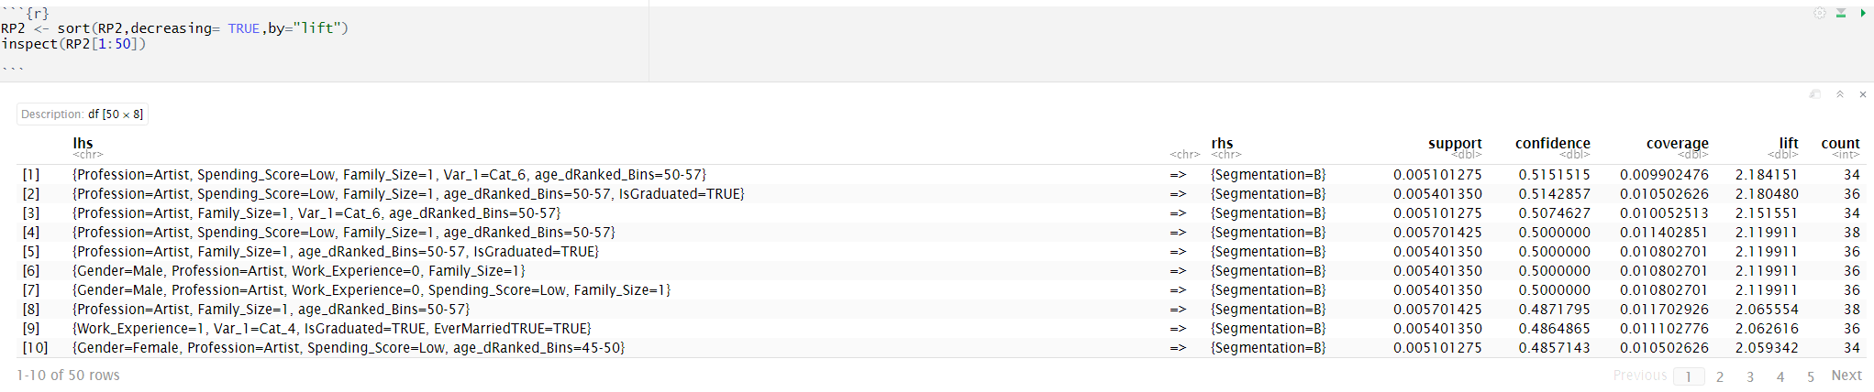
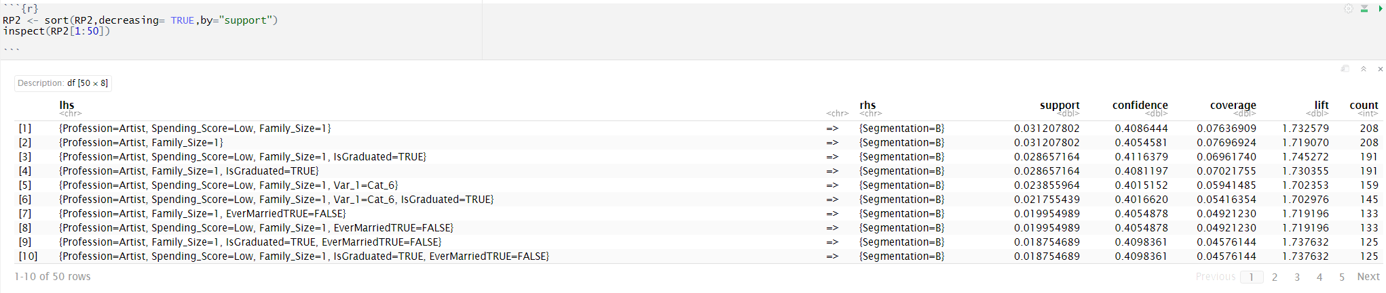
Single people with spending scores at 45-57 age but no definitive answer

Slide 13
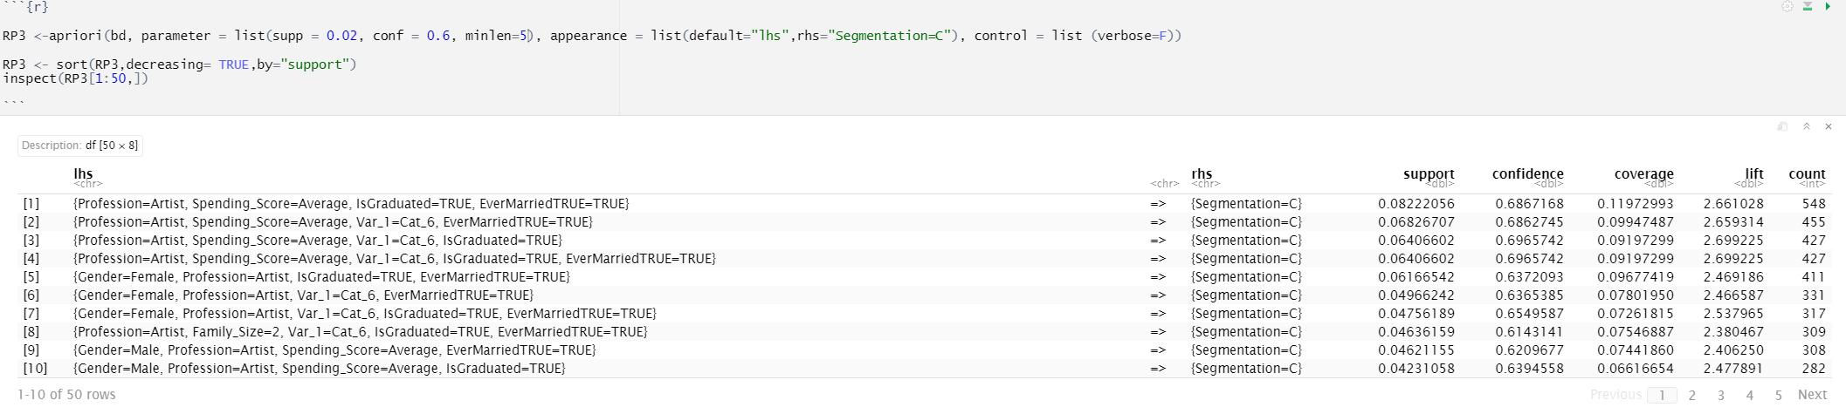
Segment C
Higher lift and confidence
After trying multiple parameters the best was
supp = 0.02, conf = 0.6,minlen=5

Slide 14
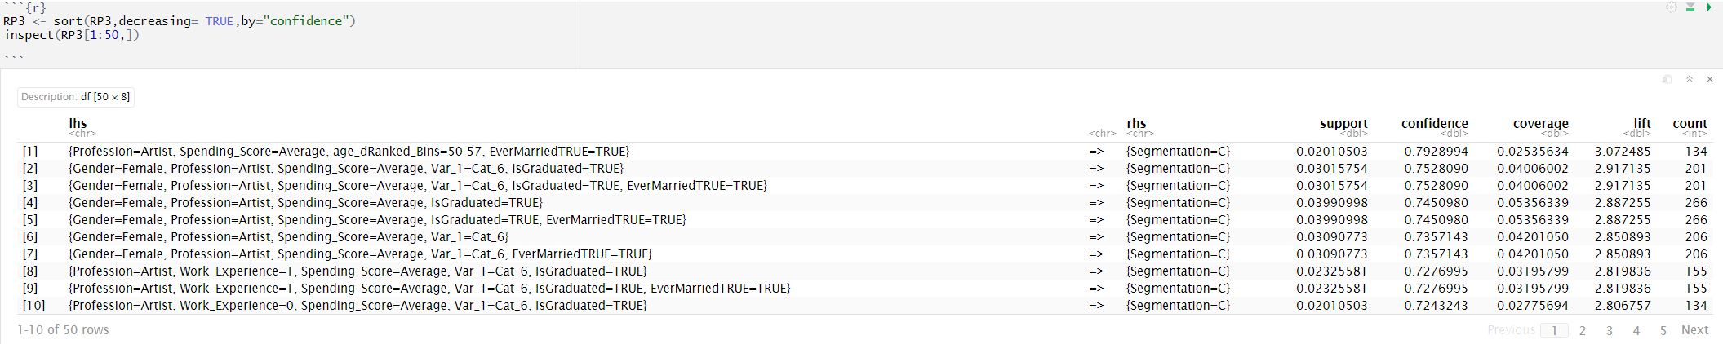
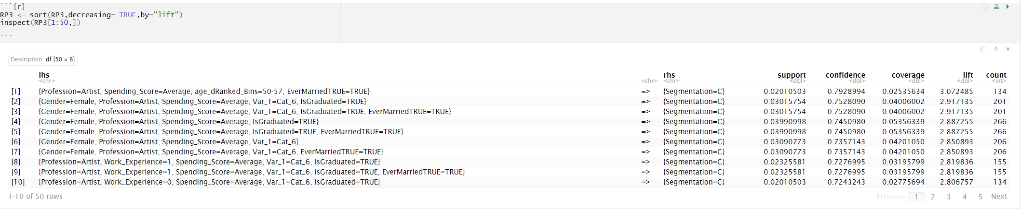
Artists in family of 2 with average spending scores that graduated

Slide 15
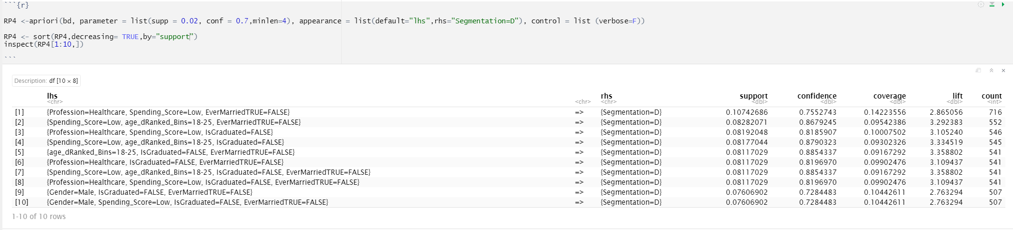
Segment D
Very high confidence and life for rules found
Highest of all variables we have seen so far.
After trying multiple parameters the best was
supp = 0.02, conf = 0.7,minlen=4

Slide 16
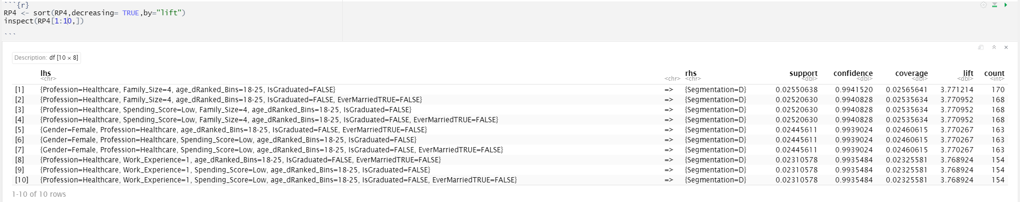
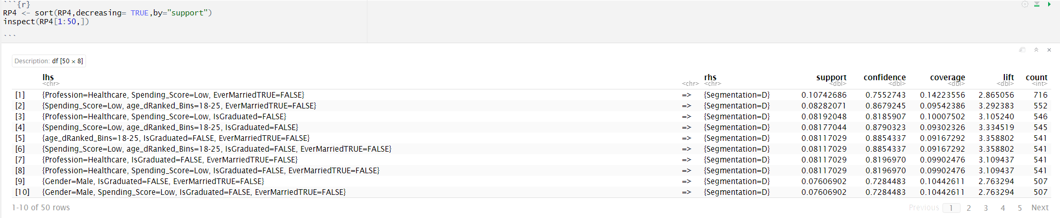
Healthcare workers mainly young adults still at home.

Slide 17
Classification Overview
Classification Methods to Consider:
Decision tree methods
Basic
Random Forest
Other Parameter Tuning
Xg Boost
KNN
Determine which evaluation metrics we want to use, apply them to model outputs, determine best model for prediction
Notes:
Paul S

Slide 18
Decision Tree (CART)
Packages: rpart, caret
Parameters Tuned
MaxDepth (GridSearchCV for tuning)
MinSplit (Manual 5-Fold CV)
Best Observed Configuration
MaxDepth=5
MinSplit=250
Best Accuracy: 0.501
Very little accuracy difference between parameter values tested
Notes:
Paul P

Slide 19
k-Nearest Neighbors
Packages: class
Parameters Tuned
K-Neighbors (Manual 5-Fold CV)
Best Observed Configuration
K-Neighbors=7
Best Accuracy: 0.874
Notes:
Paul P

Slide 20
K-Nearest Neighbors
5-Fold Confusion Matrix
 | Predicted
Original |  | A | B | C | D
 | A | 1437 | 174 | 5 | 0
 | B | 150 | 1299 | 116 | 7
 | C | 1 | 84 | 1487 | 148
 | D | 1 | 7 | 138 | 1611
Notes:
Paul P

Slide 21
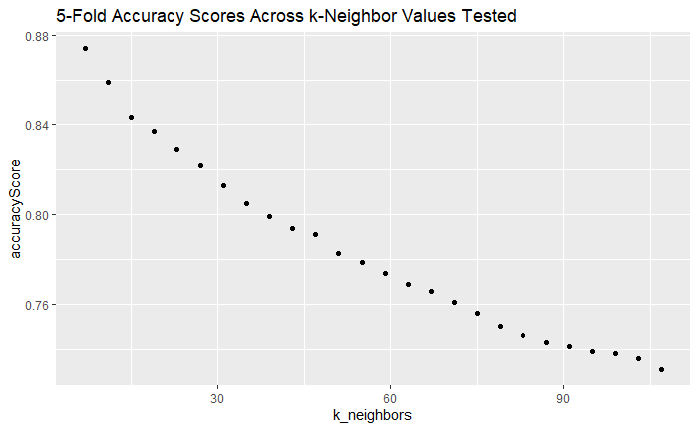
k-Nearest Neighbors
Notes:
Paul P

Slide 22
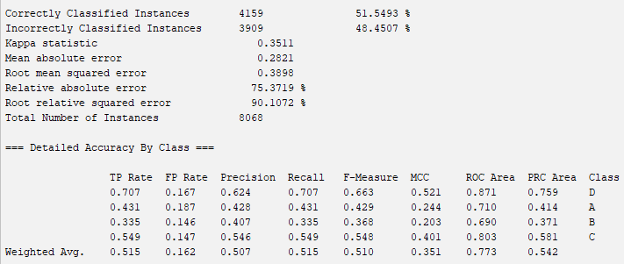
Random Forest

Slide 23
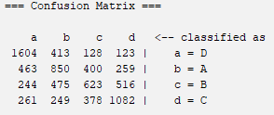
Random Forest

Slide 24
XGBoost Classification
XGBoost is known for high prediction accuracy with certain data sets
Validate predictions from other modeling techniques
XGBoost does not work well with non-binary categorical data
Our dependent variable has four classes
Most of the data set is categorical data
Requires conversion to Sparse Matrix
One potential application for XGBoost with this data is feature importance
Used XGBoost to determine features used to determine if a customer should be included in a chosen segment (A,B,C,D)
Some segments rely on profession and education, while others largely ignore
Most segments use age and family size as indicators
Spending score utilized by all segments to different degrees
Notes:
Paul S
One model we intended to use was XGBoost, which is an esemble ml method for boosted tree classification. XGBoost is known for high prediction accuracy, so idea was to validate other results.
Problem is relies on numerical data, too much categorical in our data set.
working with xgboost requires converting to sparse matrix, which does not work well with multinomial classification.
XGBoost determined not good for classification, but decent backup verification for varImp.

Slide 25
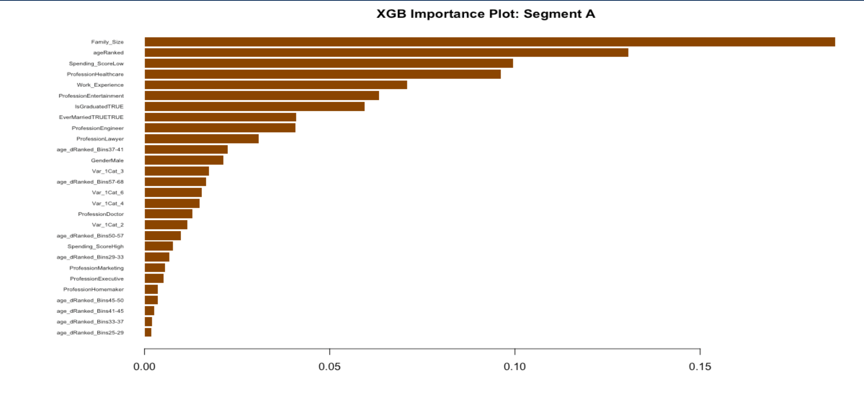
XGBoost Feature Importance: A
Most Important Features
Family_Size
ageRanked
Spending_Score = Low
Profession = Heathcare
Work_Experience
Notes:
Paul S

Slide 26
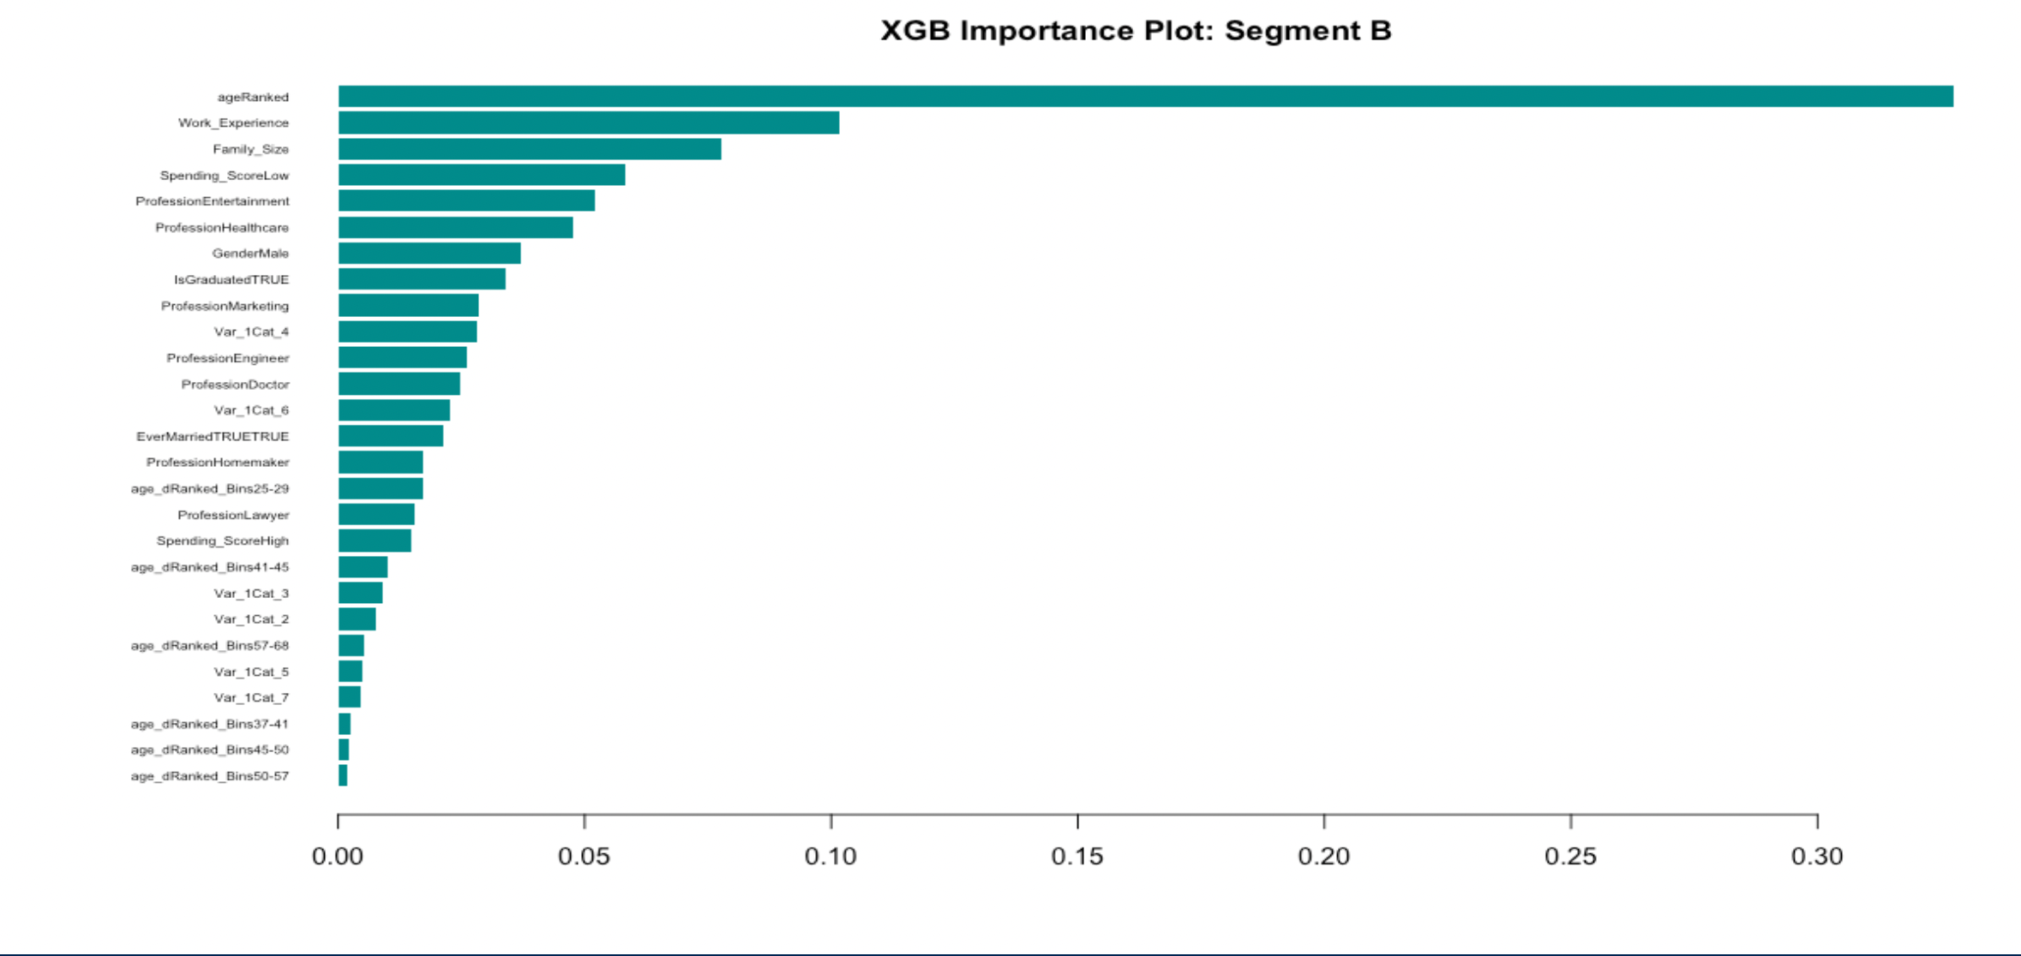
XGBoost Feature Importance: B
Most Important Features
ageRanked
Work_Experience
Family_Size
Spending_Score = Low
Profession = Entertainment
Notes:
Paul S

Slide 27
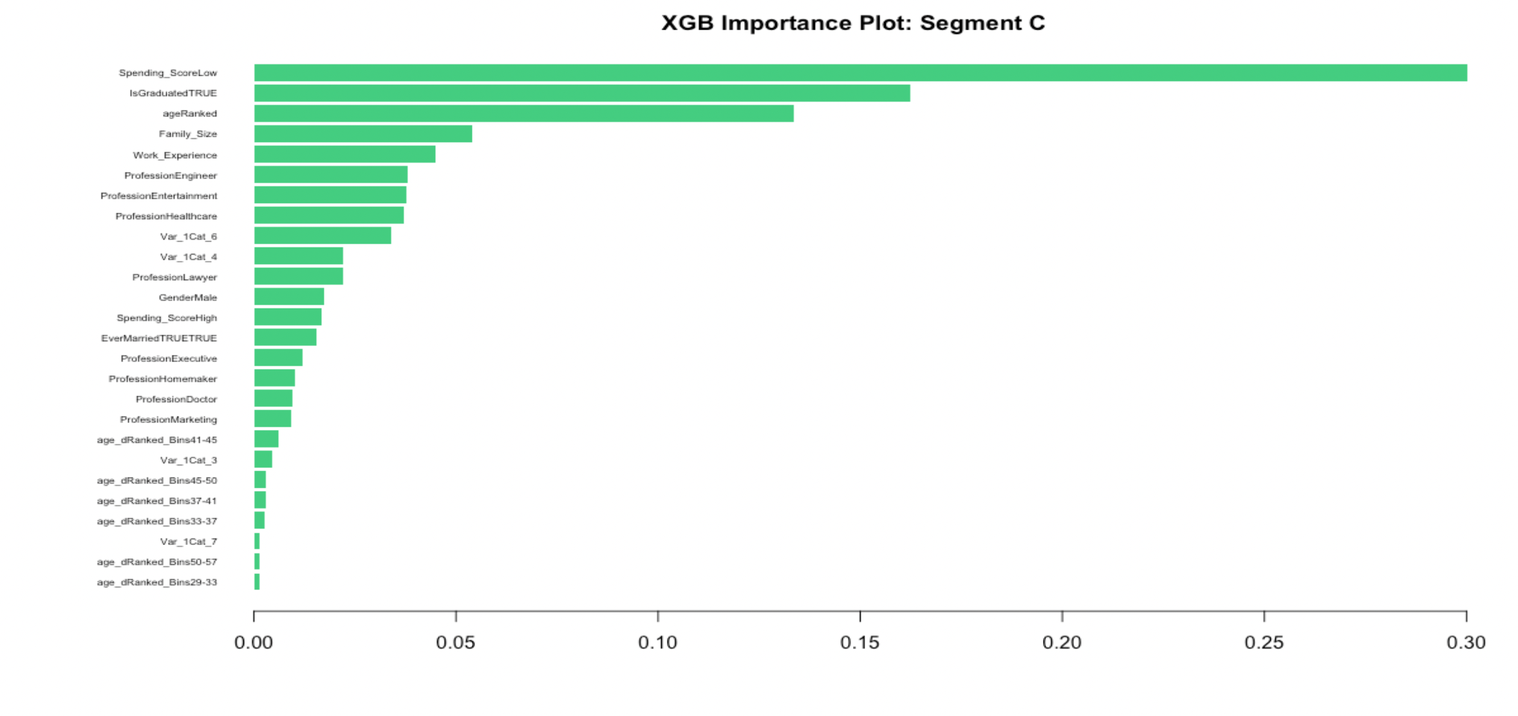
XGBoost Feature Importance: C
Most Important Features
Spending_Score = Low
IsGraduated = TRUE
ageRanked
Family_Size
Work_Experience
Notes:
Paul S

Slide 28
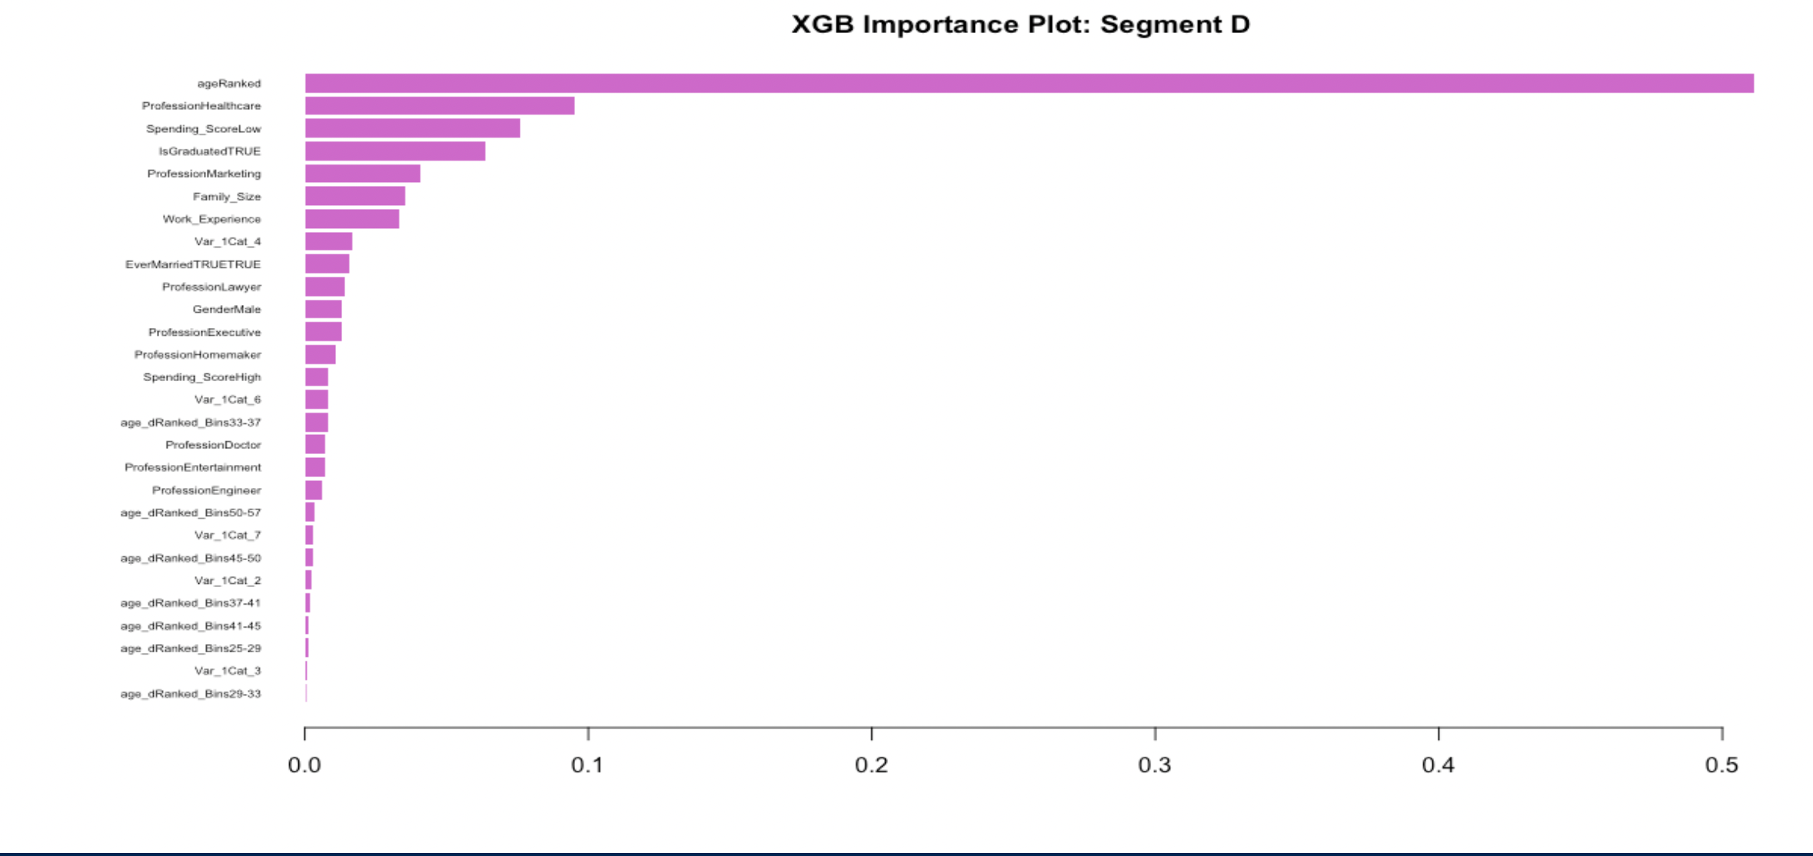
XGBoost Feature Importance: D
Most Important Features
ageRanked
Profession = Healthcare
Spending_Score = Low
IsGraduated = Yes
Profession = Marketing
Notes:
Paul S

Slide 29
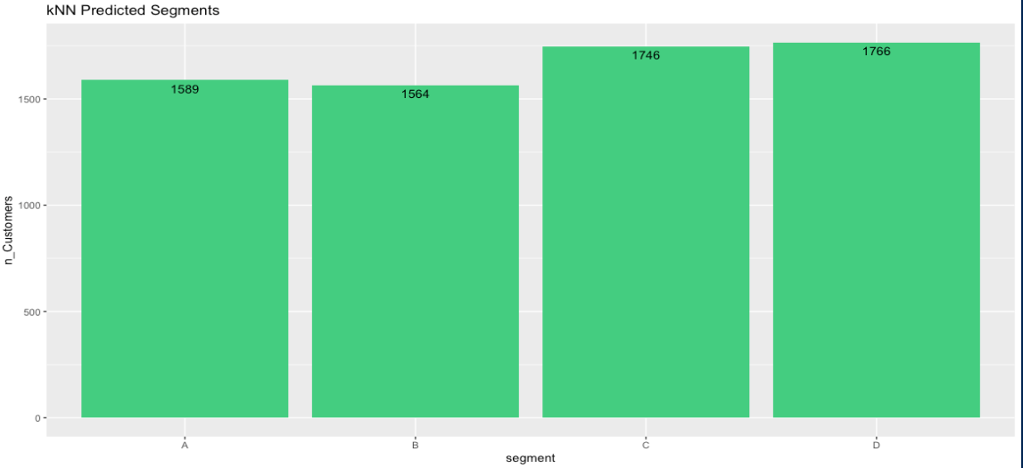
Next steps
Our current best model is Knn with 87% accuracy.
Other models are not even close
SVM
NaiveBayes
Deep learning models

Slide 30
Resources
Data: Kaggle Page
Terminology
Customer Segmentation & Categories
Spending Score
Rpart Decision Tree: link

Slide 31
Final Consluion:
## models accuracies ## 1 kNN 87.52 ## 2 Naive Bayes 56.00 ## 3 Random Forest 53.37 ## 4 SVM - Radial 50.88 ## 5 Decision Tree 50.08

